Slide 1
Residuals Management for AguaClara Plants
MESh
Matt Snyder, Emily Wood, Shania Fang
Notes:
Link to Report: https://colab.research.google.com/drive/1EET2evNI2OfCE4rr-hHRMoGD01d8zWra#scrollTo=ok9sgsscVz4D

Slide 2
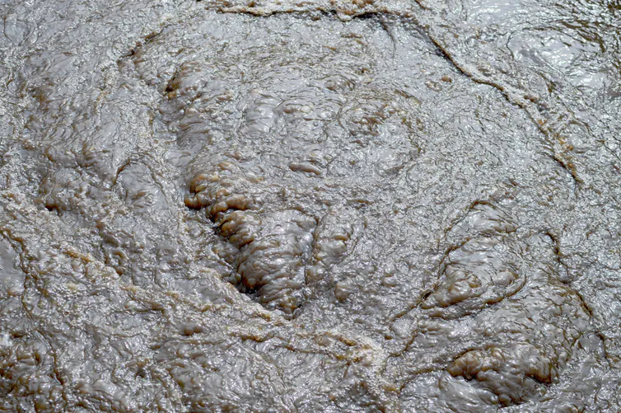
Residual Waste is mostly ‘Concentrated River’
1) Backwash Water
2) Sludge
3) Water from treatment failures
Sludge!
Notes:
Presenter: Emily
Figure Source: Can we turn sewage 'sludge' into something valuable?
Figure Caption: An image of sewage sludge which may resemble the sludge produced by AguaClara plants
Summary:
Residual waste from AguaClara plants consists of backwash water used to clean filters, sludge removed from the sedimentation basin, and wasted water during treatment failures. These materials by themselves do not present a threat to the environment, since they are primarily composed of clay, dirt, organic matter, and some coagulant. This waste is currently combined in a pipe, carried away from the plant, and released directly into the environment. With past AguaClara plants serving relatively small populations, this method of handling residuals has not provided an issue financially or environmentally. However, problems are arising as AguaClara plants continue to increase in size.

Slide 3
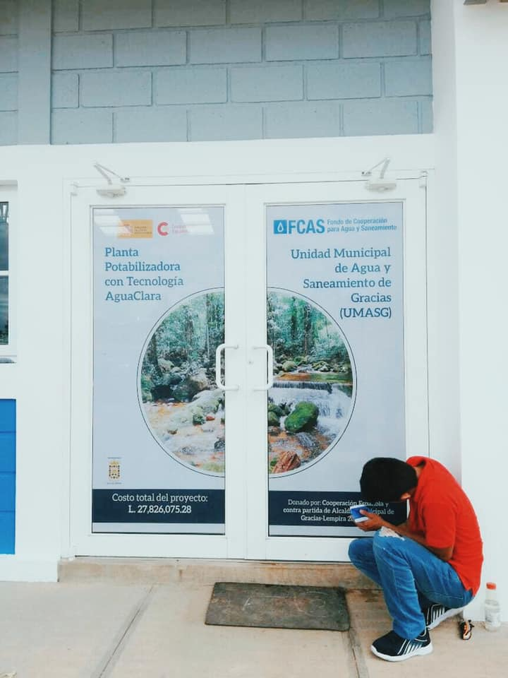
Installing pipelines for residual transport inflates plant cost
Total Plant Cost:
$974,591.59
Residuals Pipeline Cost:
≈ $70,000.00
= 7% of the total plant cost!
Yikes!
Entrance to 120 L/s plant at Gracias, Honduras
Notes:
Presenter: Emily
Figure Caption: The entrance to the 120 L/s water treatment plant in Gracias, Honduras, the largest AguaClara plant to date
Figure Source: https://www.facebook.com/CUAguaClara/
Summary
The largest AguaClara plant to date was inaugurated on November 8, 2019 in the town of Gracias, Honduras. It serves a population of 20,000 people at a flow rate of 120 L/s. The town paid 1.7 million Lempiras (about 70,000 usd) just to build a residuals pipeline which is about 7% of the total plant cost. This cost could be reduced by designing on onsite residuals management system. Additionally, incorporating a recycle stream would reduce the amount of water wasted unnecessarily by AguaClara plants.

Slide 4
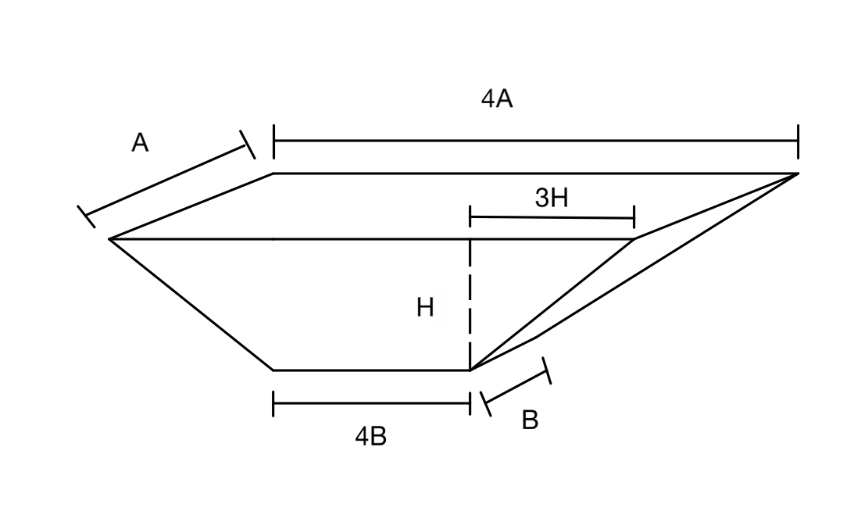
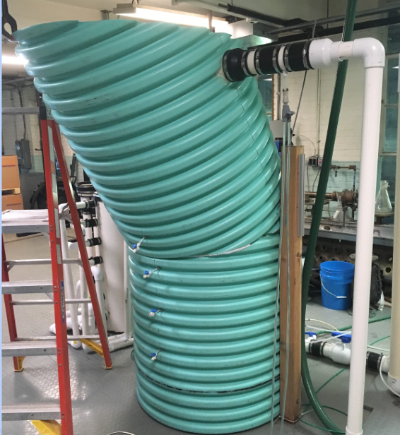
Two options: Lagoons or a Plantita
Differences in turbidity: split up backwash water and sludge
Elevation change: electric pump to bring water back to inlet of plant
Lagoons
Minimum of 2 needed per source
Majority of cost is up front for construction
Minimal operating cost
Plantita
Large cost for construction
Operating costs high
Still produces sludge and backwash water
Conclusion: Lagoons are the best option
Notes:
Figure Source: https://docs.google.com/presentation/d/1beXxfFk0Zb6vNhiRZd7WTKsvpil8FLFxB8vfp_9dHnY/edit#slide=id.g346a079b2f_0_0
There are two main ways to manage residual waste: 1) a miniature plant and 2) lagoons. A miniature plant could be used so that the backwash water and sludge would run through it. An additional electrical pump would need to be installed to recycle the water back up to the top of the original water treatment plant. This method would easily meet any and all of the EPA regulations and provide even cleaner water to rerun through the plant. However, building a miniature plant is more costly, presents fabrication challenges, requires regular monitoring, and would still produce residual wastes of its own. Furthermore, it does not solve the problem of getting rid of sludge and is more of a redundant process where the water just gets treated over again. There is an even cheaper alternative which is building a set of sludge lagoons and a set of backwash lagoons. A new AguaClara plant would be designed to keep backwash water and sludge separate so that they could enter their respective lagoon without mixing. This separation is ideal due to the large differences in turbidity and volume of the two wastes. Existing AguaClara plants could separate backwash water and sludge by laying a row of bricks in the residuals channel. A minimum of two sludge lagoons are needed so that one can fill up while the other is dried and emptied. Two backwash lagoons are also needed to handle variable flow. This method is much more cost-effective compared to building another miniature tank. A calculated volume of soil will be excavated and a synthetic/clay liner will be placed on top to prevent leakage into soil.

Slide 5
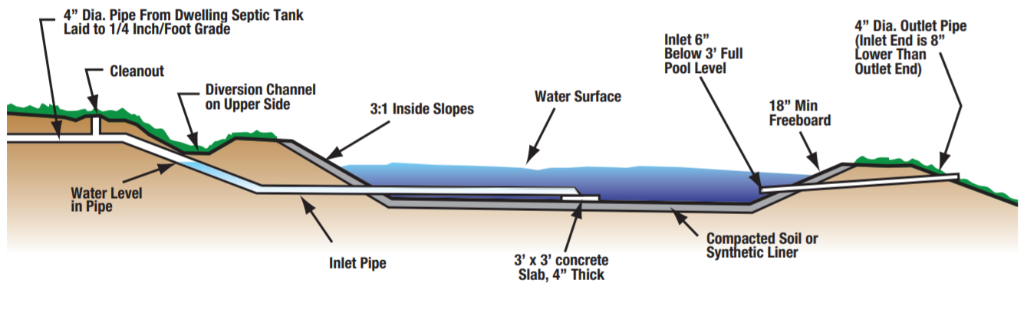
Lagoons are basically large natural storage tanks
Large pit dug into the ground
Lined with either concrete, clay or a synthetic liner
Easy to maintain once dug
4:1 Length to Width
3:1 Slope on sides
Notes:
The proposed solution for managing settled sludge waste was a lagoon drying system. This system was appealing, because of its low cost and maintenance, lack of mechanical requirements, and ability to handle intermittent and variable flow. This last point was especially important since the frequency at which a floc hopper is emptied highly depends on plant location and weather events.

Slide 6
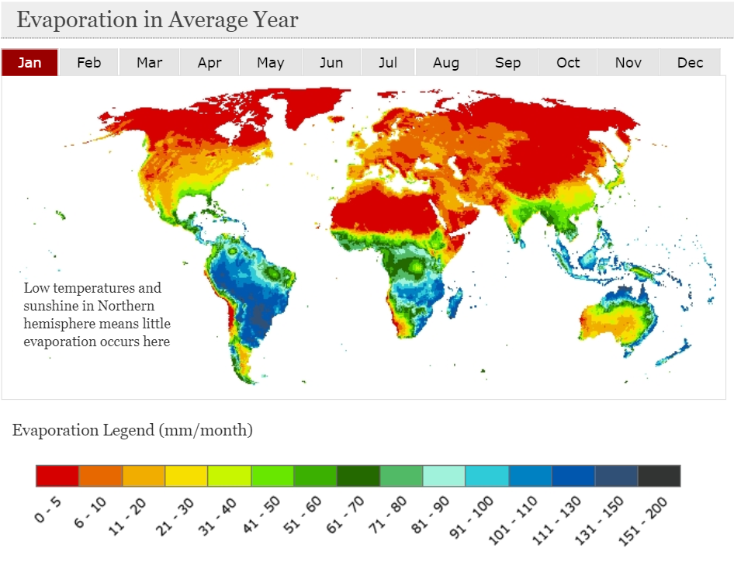
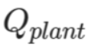
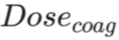
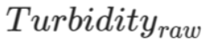
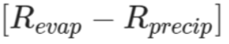
Three models were developed for the minimum area of a sludge lagoon
Some common parameters:
Notes:
Presenter: Emily
Figure Source: Evaporation in Average Year - Maps - Evaporation - Evaporation
Figure Caption: A world map of monthly evaporation rates, which was a key parameter in determining lagoon size
Summary:
The feasibility of a lagoon as a sludge management plan depends on the plan-view area necessary to dry sludge as fast as it is produced, and the cost to implement and maintain the system. Three models were developed to calculate the minimum area needed for the sludge bed. Although all methods approached the problem from a slightly different direction,there were some common parameters that appeared in all analyses: the flow rate of the plant, the average coagulant dose, the raw water turbidity, and the net evaporation rate.
The local climate is a particularly important parameter, since the lagoon can enter a failure mode if precipitation rates are greater than evaporation rates.
*note that the models are numbered in a different order in the report

Slide 7
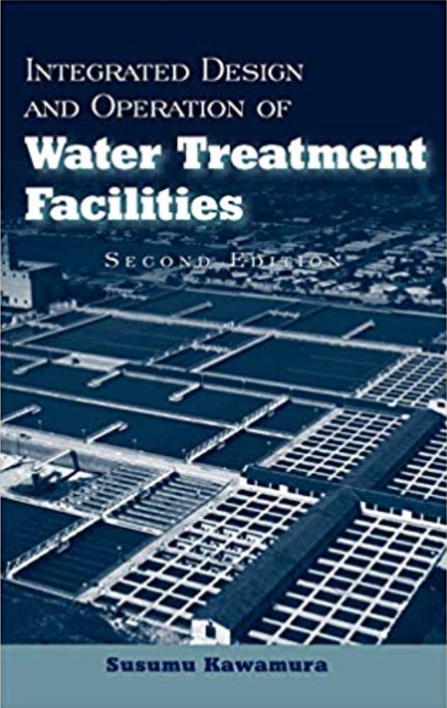
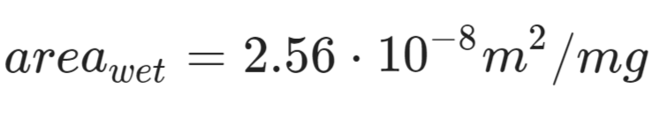
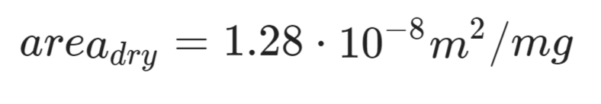
Model No. 1: The Textbook Model
Convert mass of solids to an area
Notes:
Presenter: Emily
Figure Source: https://www.amazon.com/Integrated-Design-Operation-Treatment-Facilities/dp/0471350931
Figure Caption: The textbook upon which equations for Model No. 1 were based
Summary:
This model was based on calculations performed in Kawamura’s Integrated Design and Operation of Water Treatment Facilities textbook.
Advantages:
Produces a somewhat reasonable lagoon area
Disadvantages
An empirical equation
Contains no mechanics to adjust for the specific climate of any location
No basis provided for the area conversion factors, meaning that the equation cannot be manipulated as easily to minimize lagoon area

Slide 8
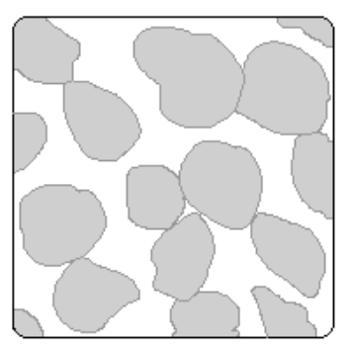
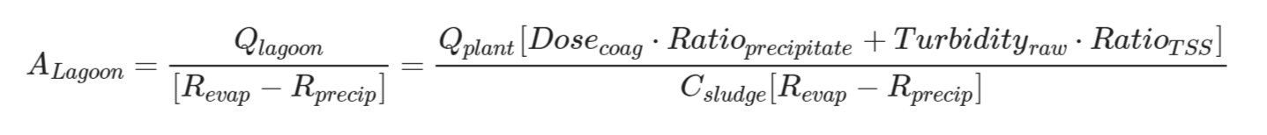
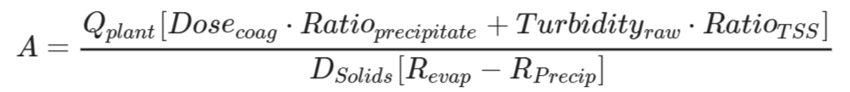
Model No. 2: The Porosity Model
A porous material!
Notes:
Presenter: Emily
Figure Source: Figure 5.1. Simplified examples of materials with high and low…
Figure Caption: The porosity of this material is the volume of voids divided by its total volume
Summary:
Primary Assumption: Water must enter the lagoon at the same rate that it evaporates
This derivation was based on the idea that the sludge entering the lagoon has some porosity. The difference in porosity between ‘wet’ sludge and ‘dry’ sludge could be used to calculate the total amount of water that needs to be evaporated by the lagoon, in a specific amount of time.
Advantages:
Incorporates the local climate
Derived from first principles, not empirical equations
Disadvantages
Does not produce a reasonable lagoon area
We do not actually know the fraction of water wasted to the floc hopper, and this number would vary greatly between plants

Slide 9
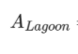
Model No. 3: The Solids Concentration Model
?
Notes:
Summary:
Primary Assumption: Water must enter the lagoon at the same rate that it evaporates
This calculation relied on the ability to convert the mass rate of solids produced to a flow rate of water entering the sludge lagoon. This volumetric flow rate was set equal to the net evaporation rate.
Advantages:
Incorporates the local climate
Derived from first principles, not empirical equations
Disadvantages
Does not produce a reasonable lagoon area
The average concentration of sludge in floc hopper water is an unknown parameter, and may be estimated in Honduras January 2020

Slide 10
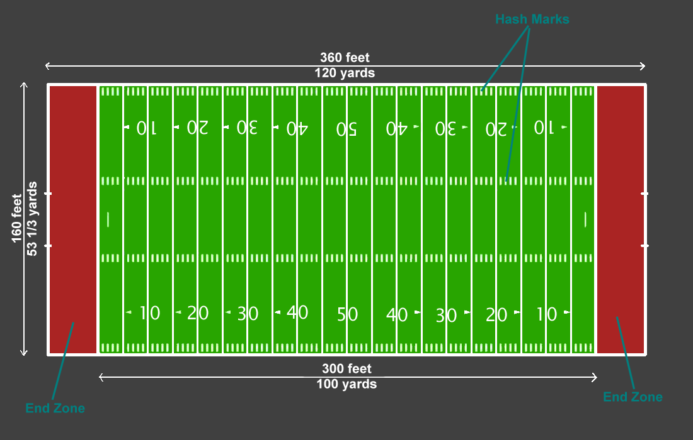
Only the first model produced a reasonable sludge lagoon area
Reference: 1 football field ≈ 5300 m²
Model Number | Required Lagoon Area
1 | 271 - 541 m²
2 | 43,630 m²
3 | 16,780 m²
Notes:
Summary:
Three models were developed to calculate the minimum area needed for a sludge lagoon, based on the 120 L/s flow rate at the Gracias, Honduras plant. The models produced areas of (1) 16,780 m^2, (2) 271 - 541 m^2, and (3) 43,630 m^2, respectively. For reference, a football field is about 5340 m^2. Only the 2nd model produced an area that was conceivable reasonable for an AguaClara plant to implement. The biggest contribution to land area in models 1 and 2 was the low deficit between evaporation rates and precipitation rates estimated for Honduras. Additionally, the precipitation rate for regions of Honduras may have been underestimated, meaning that the actual lagoon area needed is greater than those calculated in this report.One possible way to mitigate the effect of precipitation on sludge drying rates would be to ensure a broad and tall embankment surrounded by sufficient plant coverage to prevent flooding and erosion. Additionally, the sludge lagoon could be fitted with a drainage system that would carry excess water to the backwash lagoon. Doing so would minimize the amount of water that needs to be removed by evaporation.

Slide 11
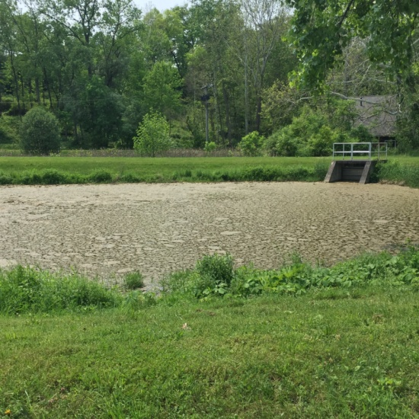
Backwash Lagoon will hold water to be pumped back to the inlet
Serves as a storage tank for the backwashing water
Allows us to hold water if many backwashing cycles required
Drains installed so that overflow won’t happen
Pump the water back up to the top of plant at 1-3% of the total flow of plant
Cornell water filtration plant lagoon
Notes:
Image source: https://pocketsights.com/tours/place/Cornell-Water-Filtration-Plant-25651

Slide 12
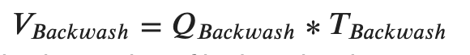
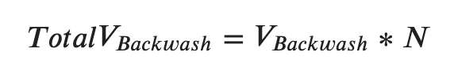
Volume of a backwash lagoon depends on filter size and backwashing time/velocity
Want to settle any particles we can
Pump the water back up
Slowly to not interrupt turbidity significantly
Volume is based on size of filters and velocity of backwash
Gracias example:
777 m³ per lagoon

Slide 13
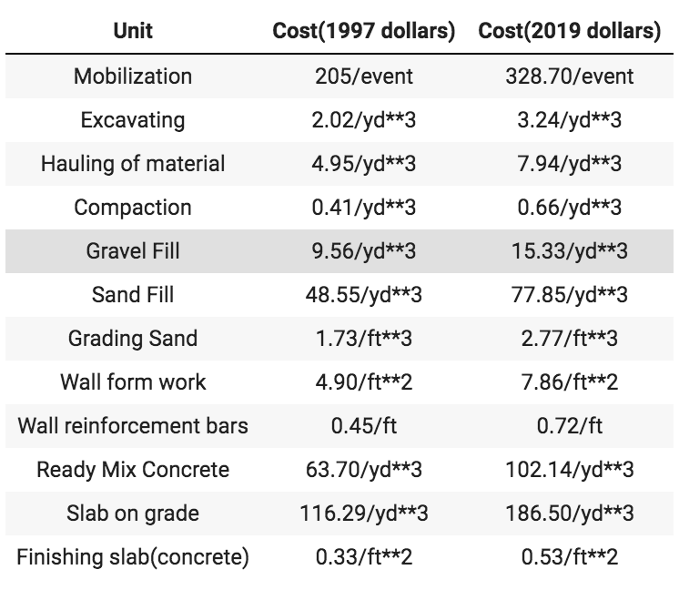
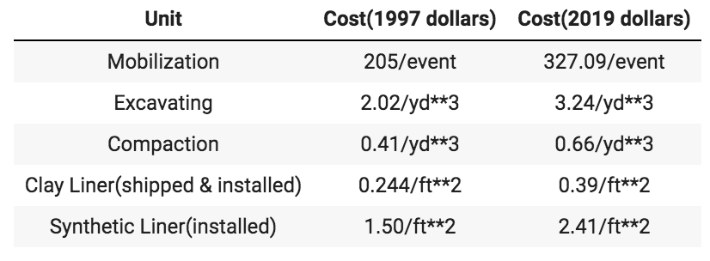
Two Options: Concrete vs Liners
Concrete
Liners

Slide 14
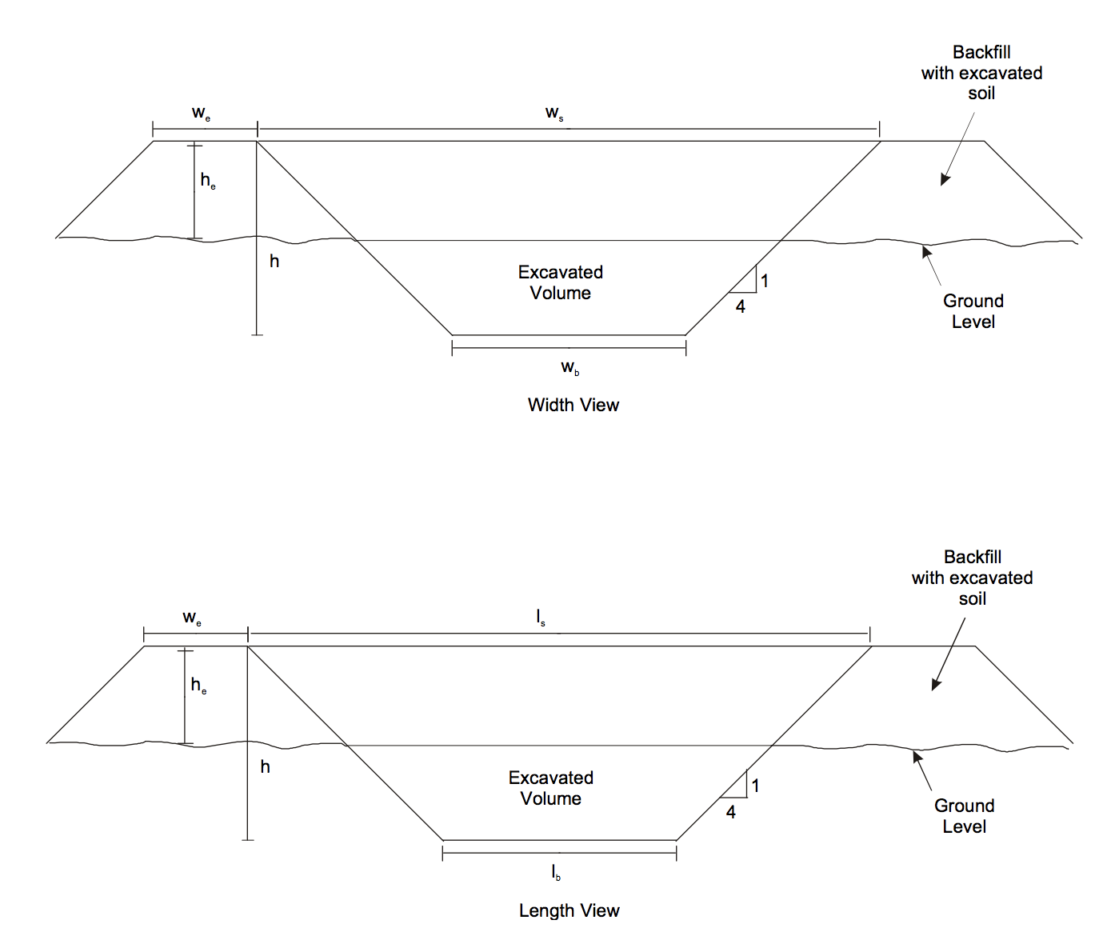
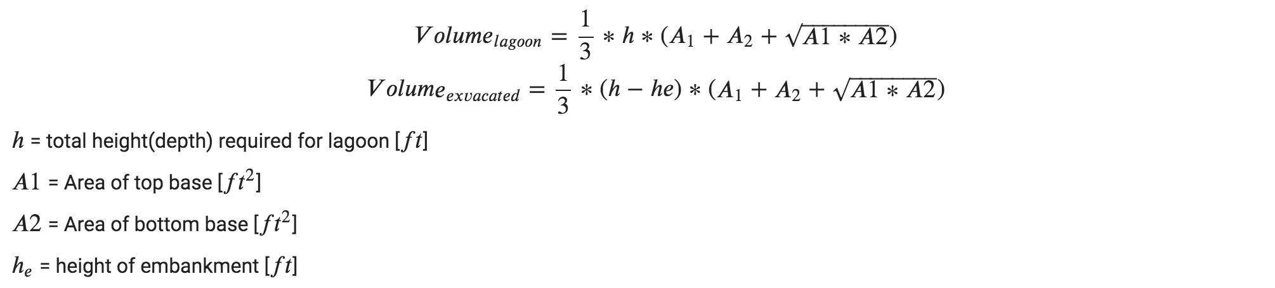
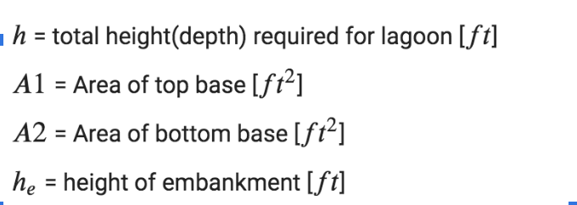
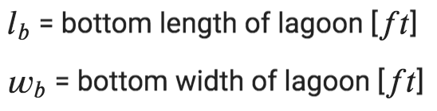
Cost Calculations
Notes:
Image source: https://www3.epa.gov/npdes/pubs/cafo_cost_method_p3.pdf

Slide 15
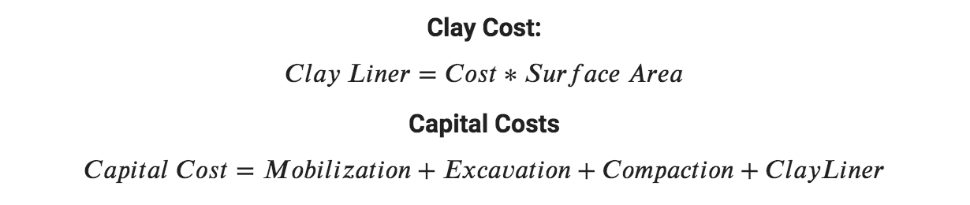
Cost Calculations Cont’d

Slide 16
Results
 | Sludge Lagoon | Backwash Lagoon
Volume (m^3) | 2,226 | 777.6
Capital Cost (USD) | 13,500 | 9,613
Annual Operating Cost (USD) | 674.80 | 480.60

Slide 17
Conclusion
≃
Two Sludge Lagoons($27,000)
Two Backwash Lagoons($19,266)
10 years of operating cost($23,108)
Gracias Residual Pipeline(70,000 USD)

Slide 18
References
Notes:
[1] United States, Congress, Office of Ground Water and Drinking Water. “Filter Backwash Recycling Rule: Technical Guidance Manual.” Filter Backwash Recycling Rule: Technical Guidance Manual, U.S. Environmental Protection Agency, 2002.
[2] United States, Congress, Office of Ground Water and Drinking Water. “Using DWSRF Funds to Comply with the Filter Backwash Recycling Rule.” Using DWSRF Funds to Comply with the Filter Backwash Recycling Rule, U.S. Environmental Protection Agency, Office of Ground Water and Drinking Water, 2002.
[3] United States, Congress, Office of Ground Water and Drinking Water. “Filter Backwash Recycling Rule: a Rule Summary for Systems.” Filter Backwash Recycling Rule: a Rule Summary for Systems, U.S. Environmental Protection Agency, Office of Water, 2002, pp. 1–10.
[4] United States, Congress, Office of Ground Water and Drinking Water. "Technology Cost Equations: Cost Methodology for the Final Revision." Technology Cost Equations: Cost Methodology for the Final Revision, U.S. Environmental Protection Agency, Office of Water, 2001
[5] Watershed Center."Maintaining Your Onsite Wastewater Lagoon System."Watershed Center, by County of Greene, 2011
[6] Kawamura, Susumu; Wiley, John; Sons. “4.2 Handling Facility for Waste Wash Water.” Integrated Design and Operation of Water Treatment Facilities, 2000, pp. 372–383.
[7] Kawamura, Susumu; Wiley, John; Sons. “4.3 Sludge Handling and Disposal.” Integrated Design and Operation of Water Treatment Facilities, 2000, pp. 384–402.
[8] Gebbie, Peter. “64th Annual Water Industry Engineers and Operators’ Conference.” Fisher Stewart Pty Ltd, USING POLYALUMINIUM COAGULANTS IN WATER TREATMENT, 2001, pp. 39–42.
[9] Water Treatment Chemicals. “Poly Aluminum Chloride (PAC).” Water Treatment Chemicals, Taki Chemical CO., LTD, www.takichem.co.jp/eng/products/water/pac.html.
[10] Centre for Ecology & Hydrology. "Evaporation in Average Year." Centre for Ecology & Hydrology, Natural Environment Research Council, http://www.waterandclimatechange.eu/evaporation/average-monthly-1985-1999

